Slide 1
.NET execution model

Slide 2
CLR
Common Language Runtime
It’s runtime, that is suitable for different programming languages.
Main features of CLR (memory management, assembly loading, security, exception handling, synchronization) are available in all programming languages that use this runtime.
Actually while executing program in CLR unimportant the language on which program is written. Software can be develop on any programming language, if only compiler supports CLR.

Slide 3
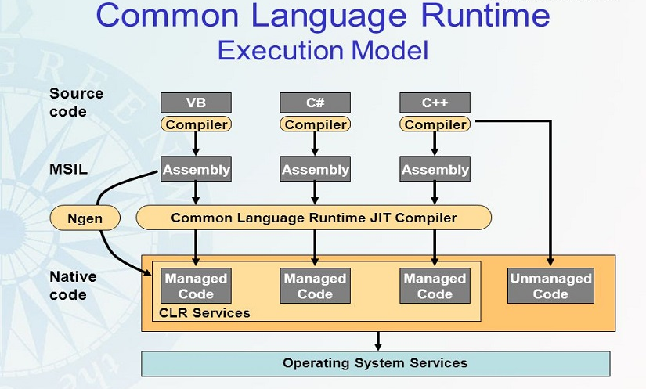
CLR

Slide 4
Preparing the program source code
Compiling in the intermediate MSIL language
Loading and analyzing the assembly with the CLR environment
Compiling the assembly with the JIT compiler
The NGen.exe* program, included in the .NET Framework package, can be used to compile IL code into machine code when the application is installed on the user's machine.
Notes:
* Because the code is compiled during the installation phase, the JIT compiler does not have to compile it at run time, which can improve the performance of the application.
The NGen.exe program is useful in two situations.
- accelerate the launch of the application.
- reduce the working set of the application.

Slide 5
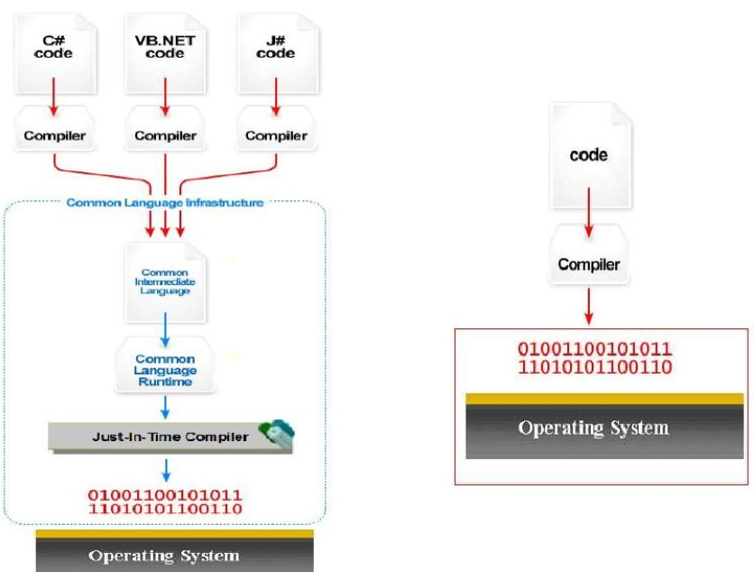
CLR

Slide 6
CLR
Managed vs unmanaged code
Managed Code:
It compiles to Intermediate Language (IL).
It runs and is managed by the CLR.
The runtime provides services such as security, memory management, threading, etc.
Unmanaged Code:
It compiles directly to machine code.
It does not run and is not managed by the CLR.
It doesn't get the services of the runtime.

Slide 7
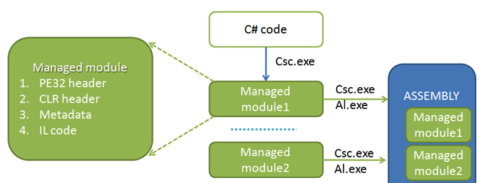
CLR
Managed code components

Slide 8
CLR
Compiler for CLR simultaneously generates IL code and metadata for each module.
Generally, metadata is a set of data tables that describes what is defined in module, for example types and their members.

Slide 9
CLR
Metadata uses
Eliminates the need for header and library files during compilation, since information about types and members is contained in file with IL code that implements it.
IntelliSense function analyzes the metadata and tells you which methods, properties, events, and fields are preferred in this case and which parameters are required by specific methods.
The CLR uses metadata to ensure that the code performs only "type-safe" operations.
Metadata allows you to serialize object fields and then transfer this data over the network.
Metadata allows garbage collector to track life cycle of object.

Slide 10
Integration of managed modules into assembly

Slide 11
DLLs in the .NET environment are replaced by assemblies. They have built-in version control. Different versions of assemblies can coexist together.
This excludes the so-called "DLL hell", which consisted in the fact that the new versions of the DLL overwritten the old ones, and because of the incompatibility of the DLL versions, the previously installed software products ceased to work.
Notes:
First, assembly is provides logical grouping of one or more managing modules and file resources.
Secondly, it is the smallest unit of multiple use, security and version control.
Assembly can consists of one or more files, it depends on selected tools and compilers.
In the context of CLR, assembly is what we commonly call component.

Slide 12
.NET security
The .NET Framework provides several mechanisms for protecting resources and code from unauthorized code and users:
ASP.NET Web Application Security
Code access security
Role-based security
Notes:
ASP.NET Web Application Security provides a way to help limit faccess to a site by comparing authenticated credentials (or representations of them) to Microsoft Windows NT file system permissions or to an XML file that lists authorized users, authorized roles, or authorized HTTP verbs.
Code access security uses permissions to help limit the access that code has to protected resources and operations. It helps protect computer systems from malicious mobile code and helps provide a way to allow mobile code to run safely. (Code access security, together with the policies that govern it, are referred to as evidence-based security.)
Role-based security provides information needed to make decisions about what a user is allowed to do. These decisions can be based on either the user's identity or role membership, or both.

Slide 13
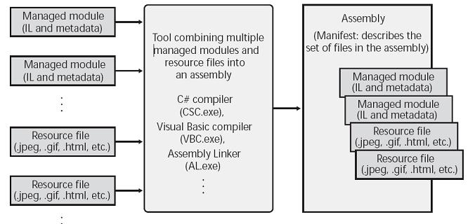
Notes:
By default, the compilers themselves perform the work of converting the created managed module to an assembly.
C # compiler creates a managed module with a manifest that indicates that the assembly consists of only one file.
So, in projects where there is only one managed module and there are no resource files (or data files), assembly is a managed module, so you do not need to perform additional actions to build the application.
In case you need to group several files into an assembly, you will need additional tools - for example, assembly linker AL.exe.

Slide 14
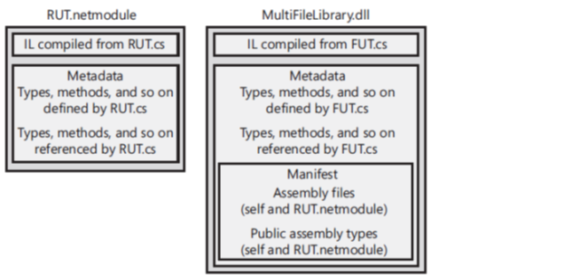
Manifest
It is another set of metadata tables that basically contain the names of the files that are components of assembly. In addition, these tables describe the version and regional standards of the assembly, its publisher, publicly exported types, and all the assembly files.
Notes:
First the CLR always loads the file with the metadata tables of the manifest, and then receives the names of the remaining assembly files from the manifest.
Some characteristics of the assembly are worth remembering:
in the assembly reusable types are defined;
assembly is assigned a version number;
Security information may be associated with the assembly.
In other assembly files, except for the file with manifest, there are no such attributes.

Slide 15
Why assembly?
The assembly allows you to separate the logical and physical representations of a component that supports multiple use, security, and version control.
The assembly modules also contain information about other assemblies they refer to (version and numbers). These data make the assembly self-describing.
CLR can determine all the direct dependencies that are required to run it. So there is no need to place any additional information in the system registry or in the AD DS (Active Directory Domain Services) domain. As a result, deploying assemblies is much easier than unmanaged components.

Slide 16
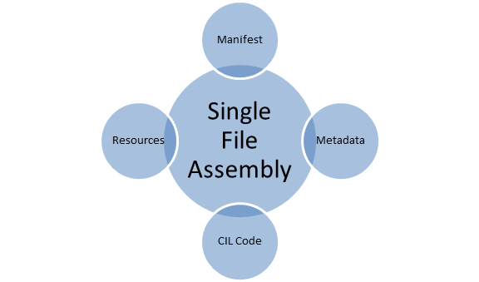
Assemblies allow you to split the process of file deployment, while all files will be treated as a single set.

Slide 17
CLR loading

Slide 18
1. The .NET Framework must be installed on the computer where the application is running.
2. Depending on the target platform, the header PE32 or PE32 + is generated, that also includes the required processor architecture (or a sign of independence from the architecture).
3. When you run the executable file, Windows analyzes the EXE file header to determine which address space is needed for its operation, 32-bit or 64-bit. A file with the PE32 header can be executed in the address space of both types, and the PE32 + header file requires 64-bit space.

Slide 19
4. After analyzing the header of the EXE file, Windows loads the corresponding version of the MSCorEE.dll library (x86, x64 or ARM) into the process address space.
5. Next, the main thread calls the method defined in the MSCorEE.dll library, which initializes the CLR, loads the EXE assembly, and then calls its main method, which contains the entry point.
6. This completes the procedure for starting a managed application.

Slide 20
In order to understand if the .NET Framework is installed on the computer, try to find the MSCorEE dll file in the
% SystemRoot% \ system32 directory.
If it is, the .NET Framework is installed*.
CLRVer.exe command-line - to display a list of all versions of the CLR installed on the machine, and also tells you which version of the CLR environment is used by the current processes.
Notes:
*However, multiple versions of the .NET Framework can be installed on the same computer at the same time. To determine which versions are installed, check the contents of the following subdirectories:
% SystemRoot% \ Microsoft.NET \ Framework
% SystemRoot% \ Microsoft.NET \ Framework64

Slide 21
Code execution

Slide 22
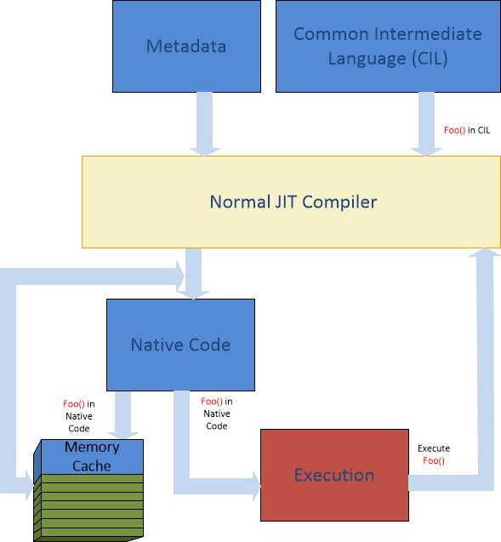
To execute a method, its IL code must be converted into machine instructions. This is done by the JIT-compiler (Just-In-Time) of the CLR.

Slide 23
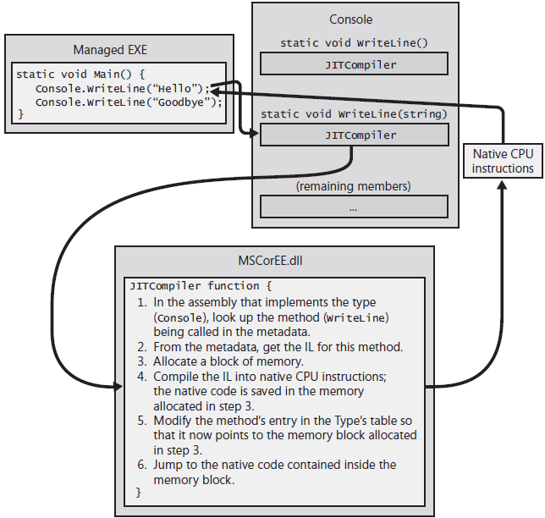
Notes:
Before the execution of the method, the CLR finds all data types on which method is referenced. CLR allocates internal data structures used to control access to referenced types.
This structure contains one record for each method defined in type. Record contains address of method implementation.
When structure is initialized, the CLR writes to record the address of internal undocumented function contained in the CLR itself.
It is responsible for compiling the IL-code of the called method into processor instructions, and stores them in the dynamic memory. Because the IL code is compiled just before execution ("just in time"), this CLR component is often called a JIT compiler.
After that, JITCompiler returns to the internal data structure of the type, and replaces the address of the called method with the address of the block of memory containing the ready machine instructions.

Slide 24
Storage Model

Slide 25
birth - when allocated
death - when deallocated
lifetime - time between birth and death
run-time storage manager/memory manager
allocates objects
deallocates objects
garbage collects when memory becomes fragmented

Slide 26
Static vs Dynamic
Static
allocated once
lifetime is entire program
immortal, never deallocated
canonical example, global variables
Dynamic
allocated at run-time
lifetime is (possibly) brief
deallocated explicitly or implicitly
canonical example, local variables in subroutine

Slide 27
Heap
freelist -- list of free space
on allocation -- memory manager finds space and marks it as used changing freelist
on deallocation -- memory manager marks space as free changing freelist
memory fragmentation -- memory fragments into small blocks over lifetime of program
garbage collection -- coalesce fragments, possibly moving objects (must be careful of pointers when moving!)

Slide 28

Stack
clean and efficient support for nested functions and recursion
central concept is stack frame (also called activation record), includes
function call -- push stack frame
function exit -- pop stack frame

Slide 29
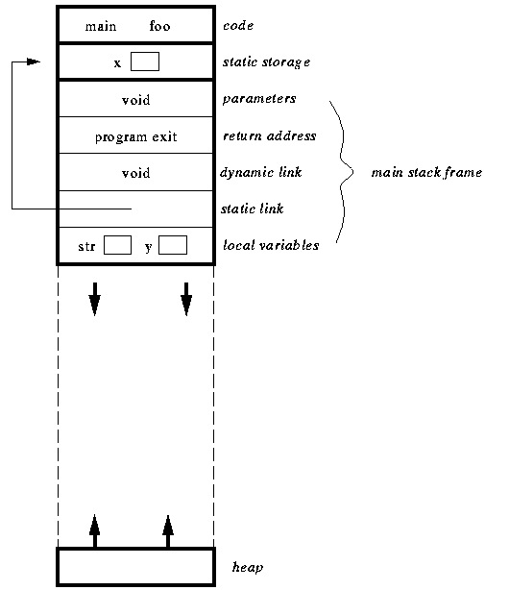
At the start of program

Slide 30
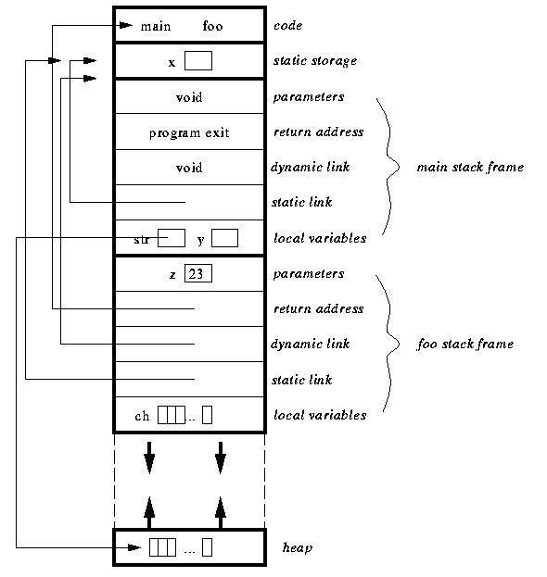
After the first call of foo

Slide 31

After the second call of foo

Slide 32
Example
internal class Employee
{
public Int32 GetYearsEmployed () { ... }
public virtual String GetProgressReport () { ... }
public static Employee Lookup(String name) { ... }
}
internal sealed class Manager : Employee
{
public override String GenProgressReport() { ... }
}

Slide 33
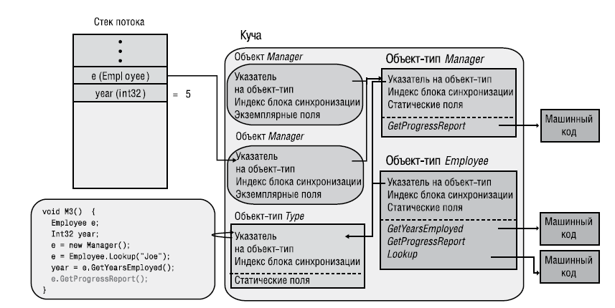
Notes:
The Windows process started, the CLR was loaded into it, the managed heap was initialized, and a thread was created (with its 1 MB of memory on the stack). In the process of converting the IL-code of the M3 method to machine instructions, the JIT compiler identifies all the types referenced in M3-these are the Employee, Int32, Manager, and String types (because of the "Joe" string). At this point, the CLR provides loading into the application domain of all assemblies in which all these types are defined. Then, using assembly metadata, the CLR gets information about types and creates data structures that actually represent these types. The data structures for the Employee and Manager object types are shown on the picture.
Finally, each type object has a method table with input points of all methods defined in the type. Since there are three methods defined in the Employee type (GetYearsEmployed, GenProgressReport, and Lookup), there are three entries in the corresponding method table.
Next, M3 executes the code to create the Manager object. In this case, an instance of Manager type is created in the managed heap, that is, the Manager object. The Manager object - as well as all other objects - has a pointer to the object-type and the index of the synchronization block.
Whenever a new object is created on the heap, the CLR automatically initializes the internal pointer to the type object so that it points to the corresponding type object (in this case, to the Manager object).
The new operator returns the address in the memory of the Manager object, which is stored in the variable e (in the thread stack). The next line of the M3 method calls the static Lookup method of the Employee object. When this method is called, the CLR locates the type object corresponding to the type in which the static method is defined. Then, based on the object-type method table, the CLR locates the entry point to the called method, processes the code with the JIT compiler (if necessary), and passes control to the received machine code.
The next line of the M3 method calls the GenProgressReport virtual instance method in Employee. When you call the virtual instance CLR, you have to do some extra work. First, the CLR refers to the variable used for the call, and then follows the address of the calling object. In this case, the variable e indicates a Joe object of type Manager. Secondly, the CLR checks the object's internal pointer to the object-type. CLR then finds the record of the called method in the method table of the object-type, processes the code with the JIT compiler (if necessary), and calls the received machine code.

Slide 34
Loader heaps are designed to load various special objects (artifacts) that exist during the entire lifetime of the domain - objects, commercial CLRs and objects that provide optimization.
The size of these heaps increases in predictable portions to reduce fragmentation.
Loader heaps are different from the heap of the garbage collector (GC Heap) in that GC Heap contains object instances, and loader heaps store type type data.
HighFrequencyHeap allocates memory for frequently used objects, and in LowFrequencyHeap - for data structures that are accessed less often.

Slide 35
Resources
1. CLR via c# 4-е издание – Джеффри Рихтер
2. https://www2.hawaii.edu/~walbritt/ics212/
examples/HeapStack.htm
3. https://msdn.microsoft.com/ru-ru/library/dd335945.aspx

